Slide 1

WHAT MAKES THE NEXT BLOCKBUSTER? ZHUOQUN SHENG HE YOU 11/30/2017

Slide 2
MOVIE PACKAGING- INVESTOR’S CONFUSION
In film industry terminology, movie packaging or film packaging is a type of product bundling where a top level talent agency starts up a film or television project using writers, directors and/or actors it represents, before giving other agencies a chance to submit their clients for the project.
——Wikipedia
DO THE DIRECTORES HAVE GREATER IMPACT ON BOX OFFICE?
WHAT IS THE MOST POPULAR CONTENTS RIGHT NOW?
WHICH MOVIE GENRE COULD GUARANTEE THE PROFIT?
SHOULD I FOCUS ON MOVIE’S GROSS OR THE PUBLIC PRAISE?
More info on our project at https://github.com/libbyYOU/IMDb-5000-movie-project

Slide 3
Contents
Data Preparation and Assumptions
Individual Analysis
Analysis into IMDb score
Analysis into gross
Comprehensive Analysis and Program Improvements
This is what you will hear from our presentation on the following 9 minutes.

Slide 4

1.
DATA PREPARATION AND ASSUMPTIONS
Clean this dirty data

Slide 5

WE GET OUR DATASET FROM
IMDb data for 5000 movies was exported from Kaggle.com
2589 unique, post-2000 U.S. movie titles were analyzed
Assumptions
Gross reflects popularity in movie market
IMDb score reflects public praise

Slide 6
Dependent Variables
Independent Variables
1.
2. GROSS
IMDb Score = 1
Variable | Attribute
Budget | Numerical
Druation | Numerical
Movie Facebook Likes | Numerical
Actor 1 Facebook Likes | Numerical
Actor 2 Facebook Likes | Numerical
Actor 3 Facebook Likes | Numerical
Cast Facebook Likes | Numerical
Director Facebook Likes | Numerical
Number of Critics | Numerical
Number of Voters | Numerical
Genre | Categorical
Plot keywords | Categorical
Title year | Numerical
Actor 1 | Categorical
Actor 2 | Categorical
Actor 3 | Categorical
Director | Categorical
IMDb Score >= 7.0?
IMDb
Score = 0
👍

Slide 7
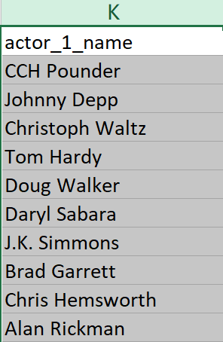
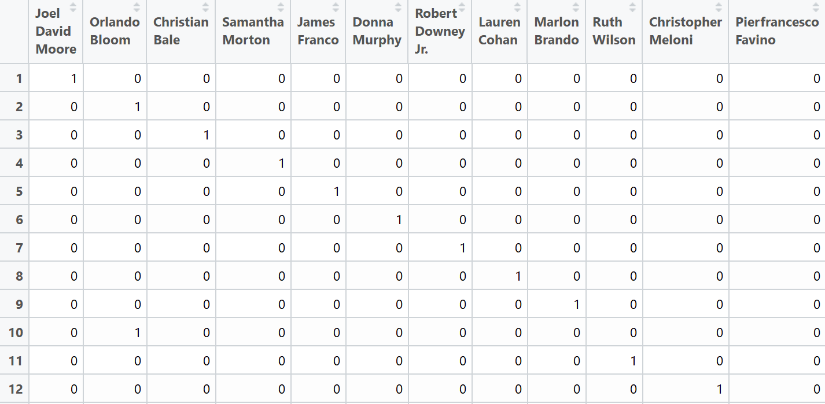
HOW WE DEAL WITH CATEGORICAL VARIABLES?

Slide 8
23
3,549
1,449
5,253
Genres
Actors
Directors
Keywords

Slide 9
WE ALSO SCALED THE VARIABLES
We calculate gross and budget in million
75% of is train data
25% of is test data
Logistic regression, LDA, QDA and KNN methods are used to
measure the IMDb_score whether higher than 7
Linear regression is used to measure the Gross
Ridge regression and Lasso regression are used to compare
categorical variable and to identify which variables have
significant influence on IMDb score and gross

Slide 10

2.
INDIVIDUAL ANALYSIS
Analysis into IMDb score
AND
Analysis into gross

Slide 11
ANALYSIS INTO IMDb SCORE
Coefficients:
 | Estimate | Pr(>|z|)
(Intercept) | 5.30E+01 | 0.185251
movie.duration | 2.84E-02 | 2.41E-11 | ***
movie.num_voted_users | 1.23E-05 | < 2e-16 | ***
movie.facenumber_in_poster | -7.659e-02 | 0.010447 | *
movie.num_user_for_reviews | -7.81E-04 | 0.00446 | **
movie.num_critic_for_reviews | 3.04E-03 | 0.000902 | ***
movie.budget | -1.95E-08 | < 2e-16 | ***
movie.aspect_ratio | -8.85E-01 | 0.00197 | **
Nothing related to Facebook is significant…
More users mean lower score while more professional critics mean higher score…
4:3 movies always get higher score?

Slide 12
SEVERAL METHODS TO PREDITCT IMDb SCORE
METHOD | GLM | LDA | QDA | KNN
MISCLASSIFICATION ERROR | 0.197 | 0.149 | 0.198 | 0.346
LDA model is the best
AND
When lasso regression is used
21.7% of genres significantly impact on IMDb score.
None of actors, keywords, directors have significantly impact on IMDb score

Slide 13
Analysis into gross
budget, duration, title year, director Facebook likes, actor 1 Facebook likes, actor 2 Facebook likes, actor 3 Facebook likes, cast total Facebook likes, movie Facebook likes, number of voted users, number of critic for reviews, face number in poster.

Slide 14
SEVERAL METHODS TO PREDITCT GROSS
 | Estimate | Pr(>|t|)
(Intercept) | 1.61E+01 | 0.01416 | *
budget | 7.37E-01 | < 2e-16 | ***
duration | -1.87E-01 | 0.00354 | **
director_facebook_likes | -1.66E-03 | 1.44E-05 | ***
actor_1_facebook_likes | -1.66E-03 | 5.64E-10 | ***
actor_2_facebook_likes | -5.71E-03 | 3.38E-09 | ***
actor_3_facebook_likes | -7.05E-03 | 6.37E-06 | ***
cast_total_facebook_likes | 5.64E-03 | 1.07E-09 | ***
num_voted_users | 2.42E-04 | < 2e-16 | ***
Linear Regression for Gross
Budget has strong positive effects on gross.
Duration has an obvious negative relationship with gross.
Facebook likes of staff seems to have little to do with gross.
Number of voted users has a slight positive relationship with gross

Slide 15
SEVERAL METHODS TO PREDITCT GROSS
Genre | Coefficient | Keyword | Coefficient
Adventure | 0.54039629 | iron man | 1.7325129
Animation | 0.33085388 | velociraptor | 1.19511312
Action | 0.30981386 | experiment gone wrong | 1.19503439
Fantasy | 0.22553026 | disaster film | 1.19489973
Sci-Fi | 0.20380205 | physical appearance | 1.14607346
History | 0.15351692 | dc comics | 1.09140279
War | 0.13753685 | teddy bear | 0.95738073
Biography | 0.08883533 | day care | 0.95737811
Sport | 0.03640468 | tentacle | 0.94949297
Family | 0.03503043 | goblin | 0.92559591
News | 0.03409123 | snowman | 0.91979423
Mystery | 0.01213348 | sister love | 0.91976416
Short | 0 | self survival | 0.90420161
Romance | -0.00106688 | fight to the death | 0.90417362
Music | -0.04436885 | terrorist plot | 0.82381366
Musical | -0.04822326 | lawlessness | 0.82378445
Thriller | -0.05213305 | imprisonment | 0.82369967
Crime | -0.05813061 | death of child | 0.80385281
Comedy | -0.0647272 | missile attack | 0.79208552
Western | -0.14187135 | human bomb | 0.7920397
According to Lasso model, 78.26% genres and 1.24% keywords contribute to gross

Slide 16
SEVERAL METHODS TO PREDITCT GROSS
Director | Coefficient | Actors | Coefficient
Colin Trevorrow | 7.307043342 | Anthony Reynolds | 1.400930145
Lee Unkrich | 4.420763514 | Conrad Vernon | 1.378292484
Chris Buck | 4.24737759 | Don Rickles | 1.335078496
Sam Raimi | 4.099274173 | Omar Sy | 1.27030978
George Lucas | 3.998223279 | Maurice LaMarche | 1.201861892
Joss Whedon | 3.864177499 | Livvy Stubenrauch | 1.201848519
Tim Miller | 3.788397717 | Alan D. Purwin | 1.04722418
Kyle Balda | 3.459938788 | Lester Speight | 1.042884567
Pete Docter | 3.181569619 | Ed Skrein | 1.037281294
Francis Lawrence | 2.9211836 | Stefan Kapicic | 1.037272367
Andrew Adamson | 2.888433709 | Keir O'Donnell | 1.032398895
Peter Jackson | 2.473987788 | Leonard Roberts | 1.032380053
Mark Andrews | 2.258396103 | Billy Boyd | 1.006461543
Andrew Stanton | 2.132797309 | Kevin Dunn | 0.942740474
Zack Snyder | 2.130138218 | Orlando Bloom | 0.902153161
Don Hall | 2.07836302 | Zack Ward | 0.841528596
Anthony Russo | 2.077894329 | John Ratzenberger | 0.839564831
Betty Thomas | 2.04332642 | Jess Harnell | 0.835581957
Christopher Nolan | 2.039271466 | Willow Smith | 0.829381564
John Lasseter | 2.020873264 | James Coburn | 0.822328922
According to Lasso model, 11.54% directors and 1.63% actors contribute to gross.

Slide 17

3.
COMPREHENSIVE ANALYSIS AND PROGRAM IMPROVEMENTS
What will make the next blockbuster?

Slide 18
What will make
the next
blockbuster?

Slide 19

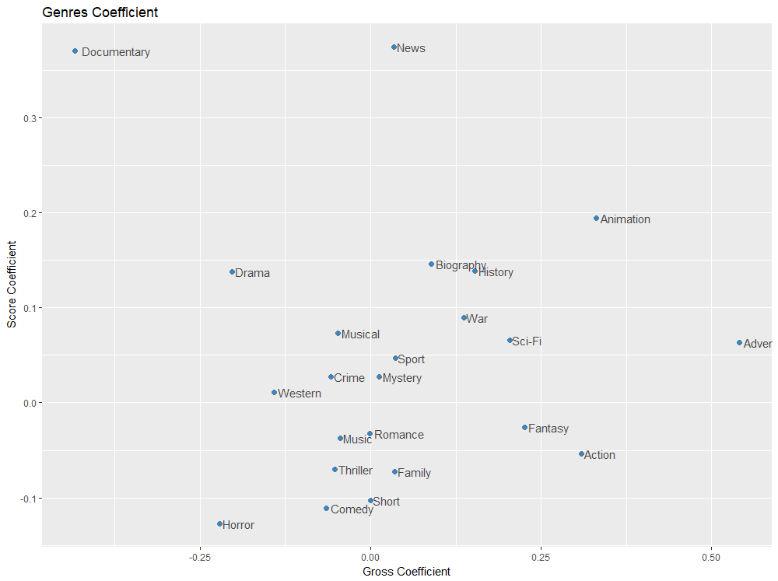
Animation is the most outstanding genre that behaves well both in gross profit and IMDb score.
Adventure, Sci-Fi, History and War, though have weaker positive impact on IMDb score, are also attractive genres.

Slide 20

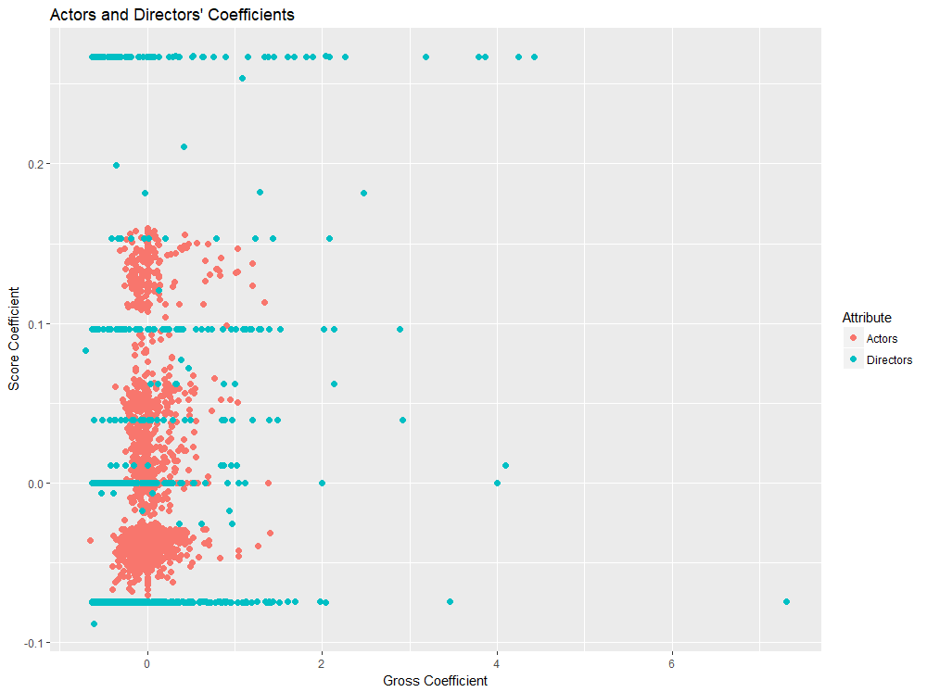
Directors have stronger influence on gross than actors. Overall, actors’ influence on IMDb score or gross do not differ from each other really much.

Slide 21
DIRECTORS WHO HAVE HIGH IMDb SCORE AND HIGH GROSS
Finding Nemo
Monsters Inc.
Toy Story
Frozen
Tarzan
Up
WALL.E
Chris Buck
Lee Unkrich
Pete Docter
The Dark Knight
Inception
The Avengers
Lord of Rings
Hobbit
Joss Whedon
Christopher Nolan
Peter Jackson

Slide 22
DIRECTORS WHO HAVE LOW IMDb SCORE BUT HIGH GROSS
Colin Trevorrow
Sam Raimi
Kyle Balda
Jurassic World
Minions
Despicable Me
Spiderman 3

Slide 23
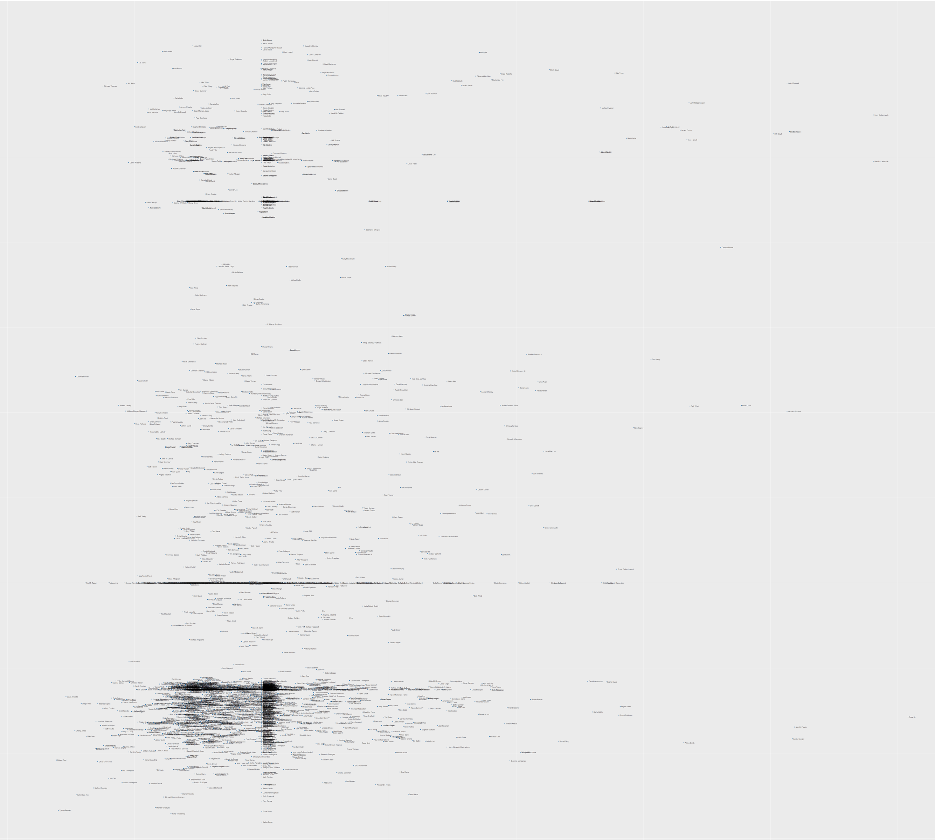
Actors Map
There are two clusters of actors who have high coefficients on both gross and IMDb score.
The first cluster is really outstanding that there is obvious blank from the second cluster.

Slide 24
ACTORS WHO HAVE HIGH IMDb SCORE AND HIGH GROSS
Zootopia
Toy Story
Cars
Frozen
Livvy Stubenrauch
Maurice Lamarche
John Ratzenberger
The Lord of Rings
The Lord of Rings
Pirates of Caribbean
Billy Boyd
Orlando Bloom

Slide 25
Actors Map
There are two clusters of actors who have high coefficients on both gross and IMDb score.
The first cluster is really outstanding that there is obvious blank from the second cluster.

Slide 26
ACTORS WHO HAVE HIGH IMDb SCORE AND HIGH GROSS
Captain American
Avengers:
Age of Ultron
The Hunger Games
Iron Man
Jennifer Lawrance
Robert Downey Jr.
Scarlett Johansson
The Dark Knight
The Dark Knight Rises
Bird Man
The Amazing Spider-Man
Christian Bale
Emma Stone

Slide 27
CONCLUSION
Budget is a vital factor leading to a blockbuster.
Facebook likes do not show obvious impact on IMDb score or gross profit.
Animation is the most outstanding genre with high IMDb score and gross.
Directors have strong impact on gross and IMDb score and those contribute to high gross can be identified.

Slide 28
LIMITATIONS
Gross is estimated data from IMDb, excluding foreign gross profit.
Genres and keywords are subjective and complex, in that every movie is a combination of several genres and keywords.
In our dataset, there are no variables evaluating movie marketing.
IMDb score is a more subjective variable compared with gross and the relationship in between is difficult to determine and analyze.

Slide 29
PROGRAM IMPROVMENTS
Use worldwide gross profit as dependent variable for further analysis.
Identify and involve variables relating marketing into analysis.
Further analyze how people decide on whether or not to watch a movie in theater .

Slide 30

Thank you very much for your time
Q&A TIME
Github link: https://github.com/libbyYOU/IMDb-5000-movie-project
Contributors: Zhuoqun Sheng
He You

